Slide 1
In Silico Comparison of Photons versus Carbon Ions in Single Fraction Therapy of Lung Cancer
Kristjan Anderle

Slide 2
Outline
Introduction
Materials & Methods
Results
Conclusion & Outlook

Slide 3
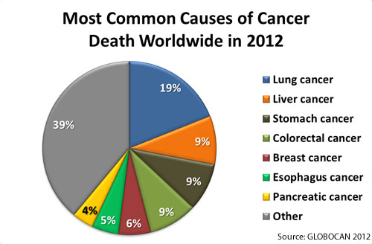
Introduction

Slide 4
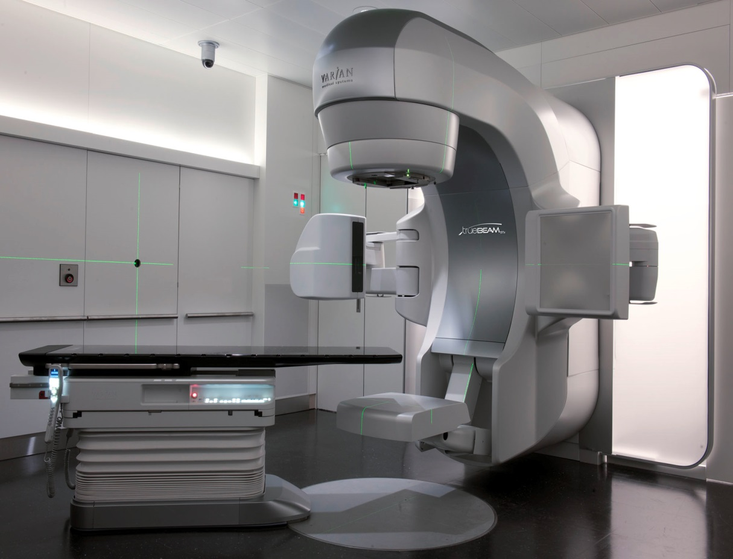
Introduction

Slide 5
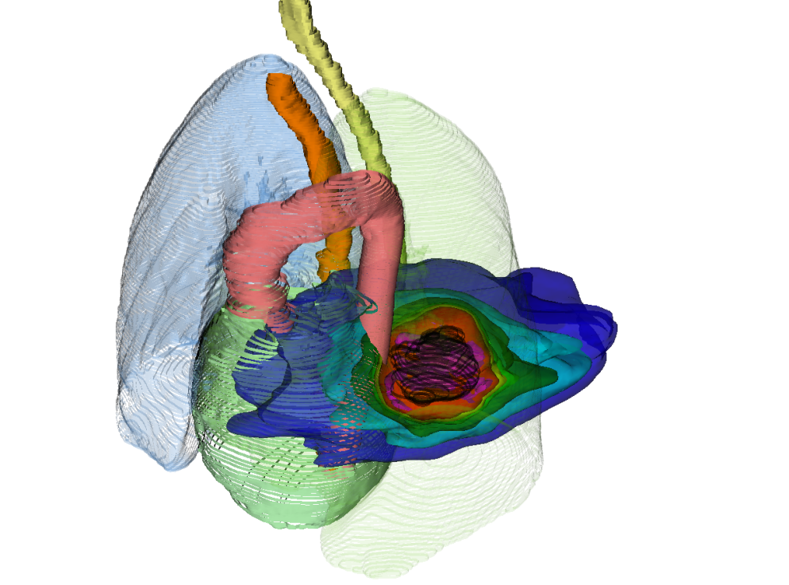
Introduction
photons

Slide 6
Introduction
photons
12C
photons
p+

Slide 7
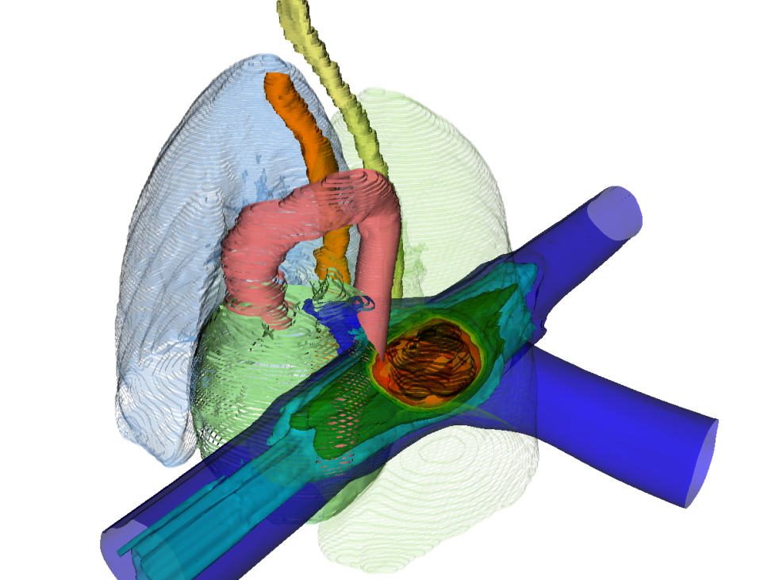
Introduction
photons
LEGENDA!
¹²C
12C
photons
p+

Slide 8
Introduction
PT Raster scanning
PT Bragg peak
PT range changes & interplay

Slide 9
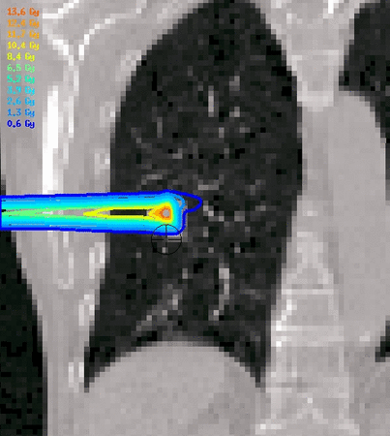
Introduction
PT Raster scanning
PT Bragg peak
PT range changes & interplay
Courtesy M. Söhn, LMU

Slide 10
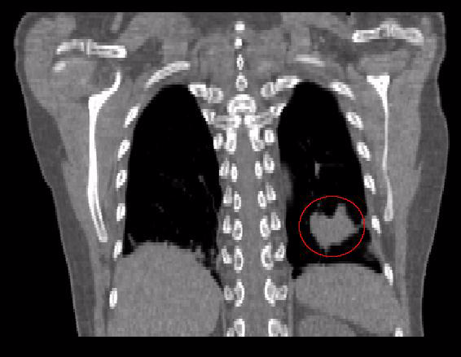
Deformable Image Registration

Slide 11

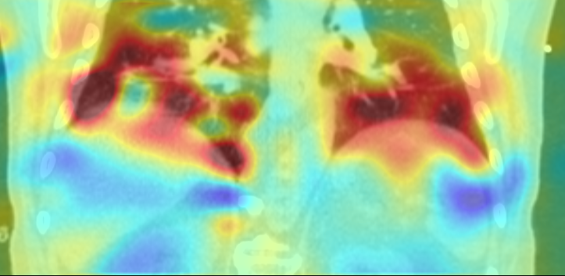
Deformable Image Registration Quality Assurance
Quality assurance with qualitative and quantitative test
Extensive verification
(1000 deformable image registrations)

Slide 12
Patient Data
19 patients, 26 tumors
Average tumor volume:
Average tumor motion:

Slide 13
Target definition
ITV vs ITV & SFUD – ify time allows

Slide 14
Patient Data – Normal Cases
19 patients, 26 tumors (each tumor 1 x 24 Gy)
Average tumor volume:
Average tumor motion:
SFUD
Dose calculation:
Without motion, static
With motion, without compensation, 4D-interplay
With motion, with compensation, 4D-rescanning

Slide 15
Patient Data - Complex Cases
8 patients, 23 tumors

Slide 16
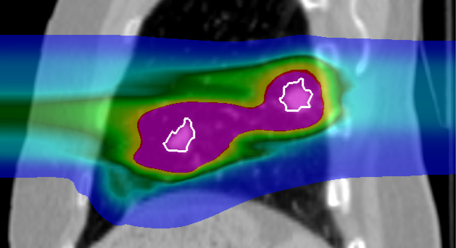
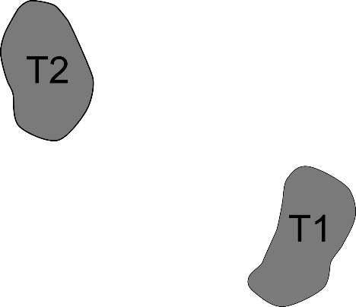
Intensity modulated particle therapy optimization for multiple targets

Slide 17
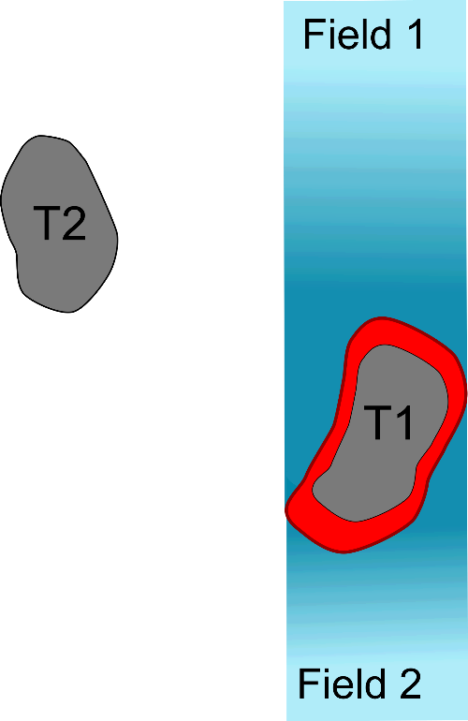
Intensity modulated particle therapy optimization for multiple targets

Slide 18
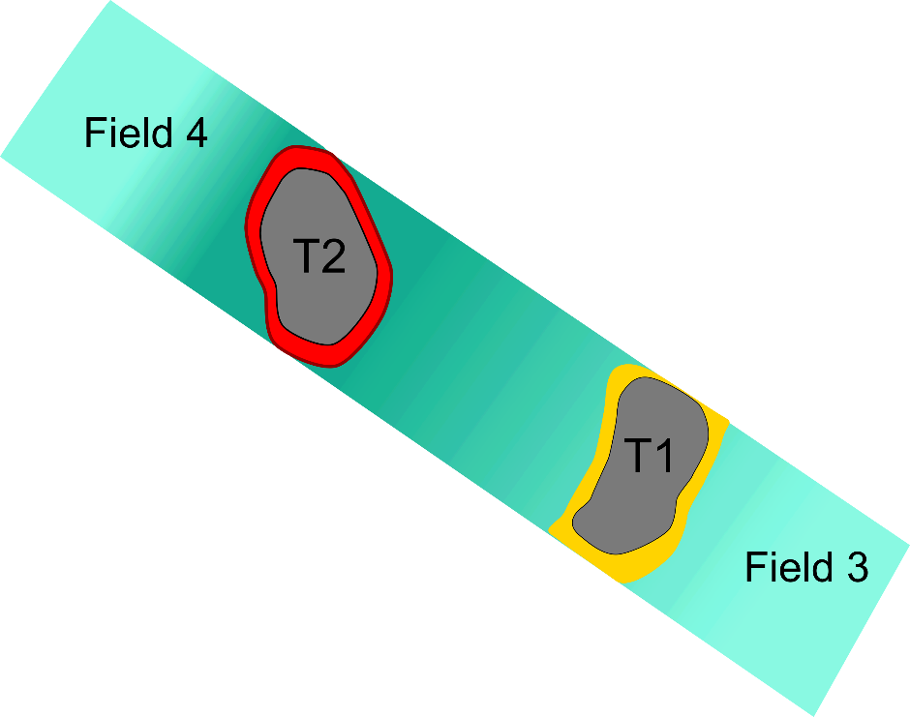
Intensity modulated particle therapy optimization for multiple targets

Slide 19
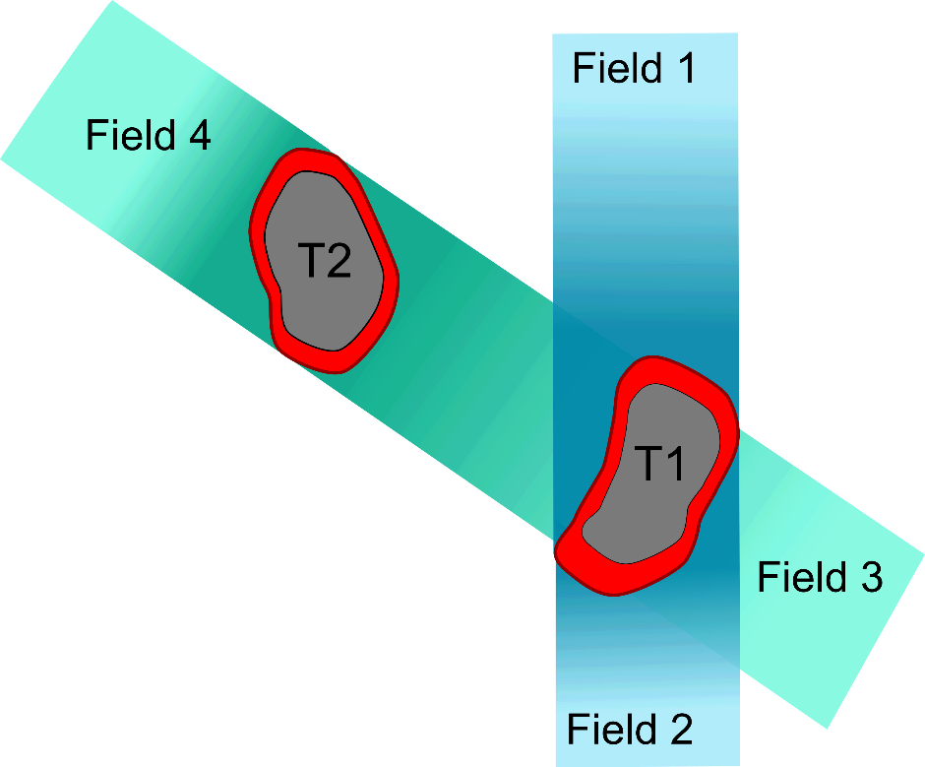
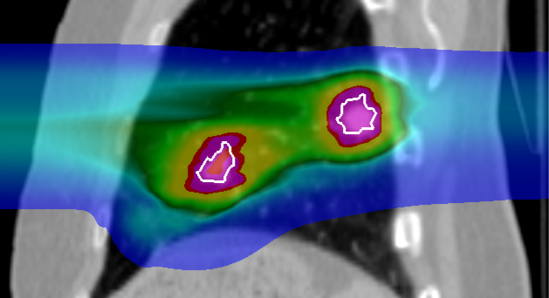
Intensity modulated particle therapy optimization for multiple targets

Slide 20
Patient Data - Complex Cases
8 patients, 23 tumors
Average tumor volume
Average tumor motion
Two optimizations
Dose calculation:
With motion, 8/patient
Dose escalation

Slide 21
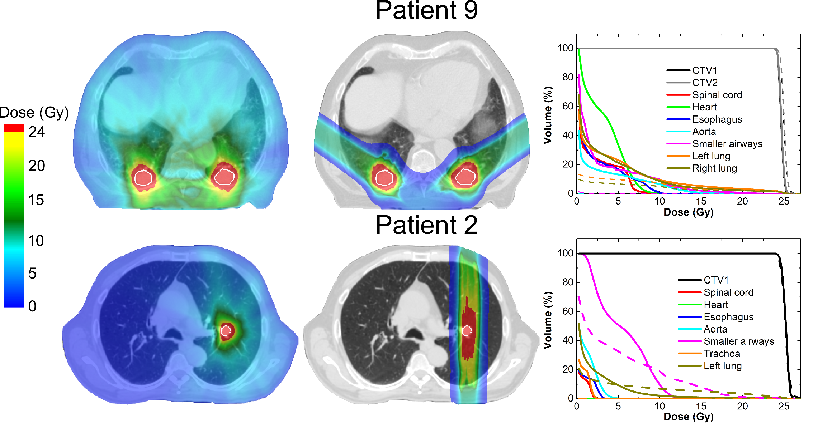

Normal Cases

Slide 22
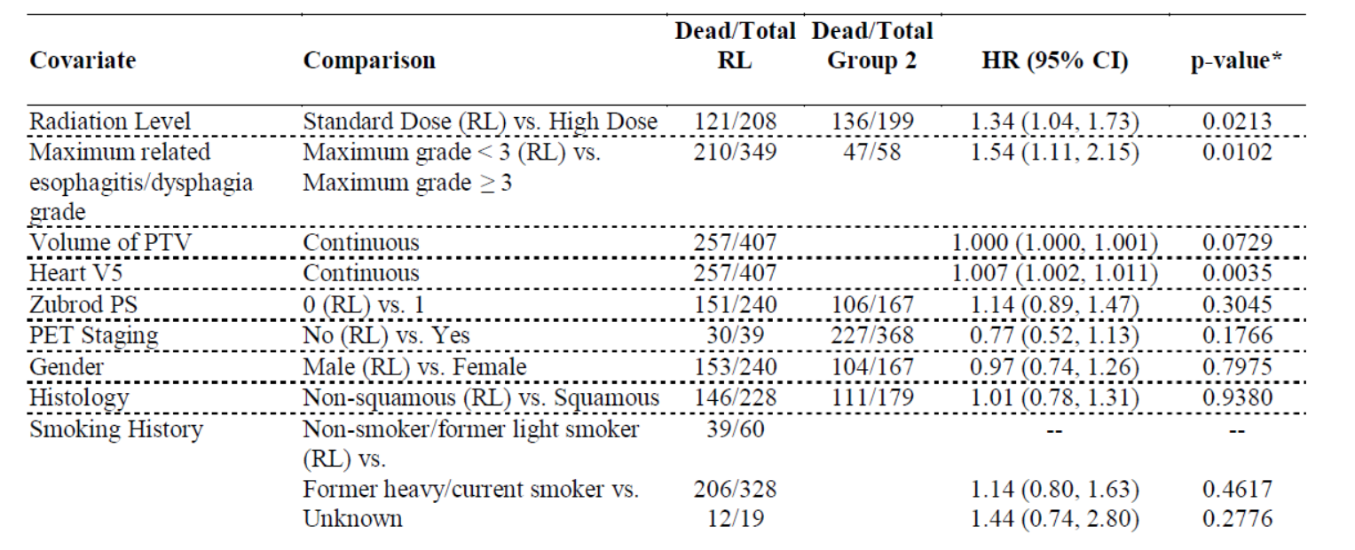
Clinical Trial RTOG 0617

Slide 23
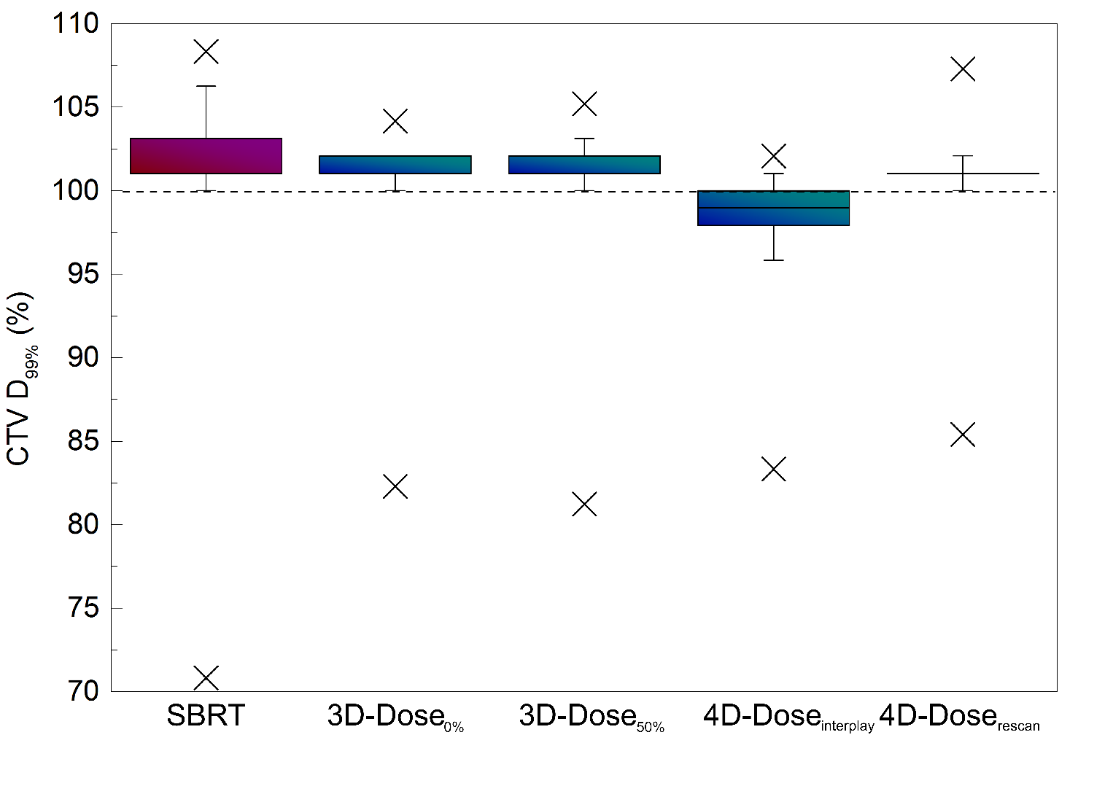
Normal cases – Tumor Irradiation

Slide 24
Normal Cases- OAR Irradiation

Slide 25
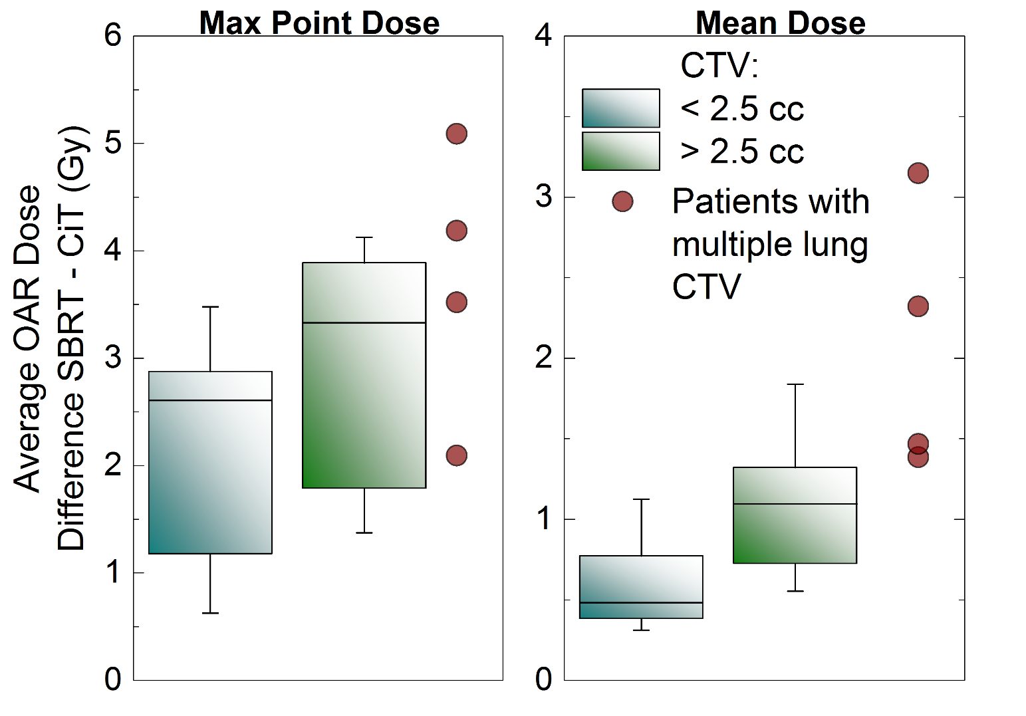
Normal cases – OAR Irradiation

Slide 26
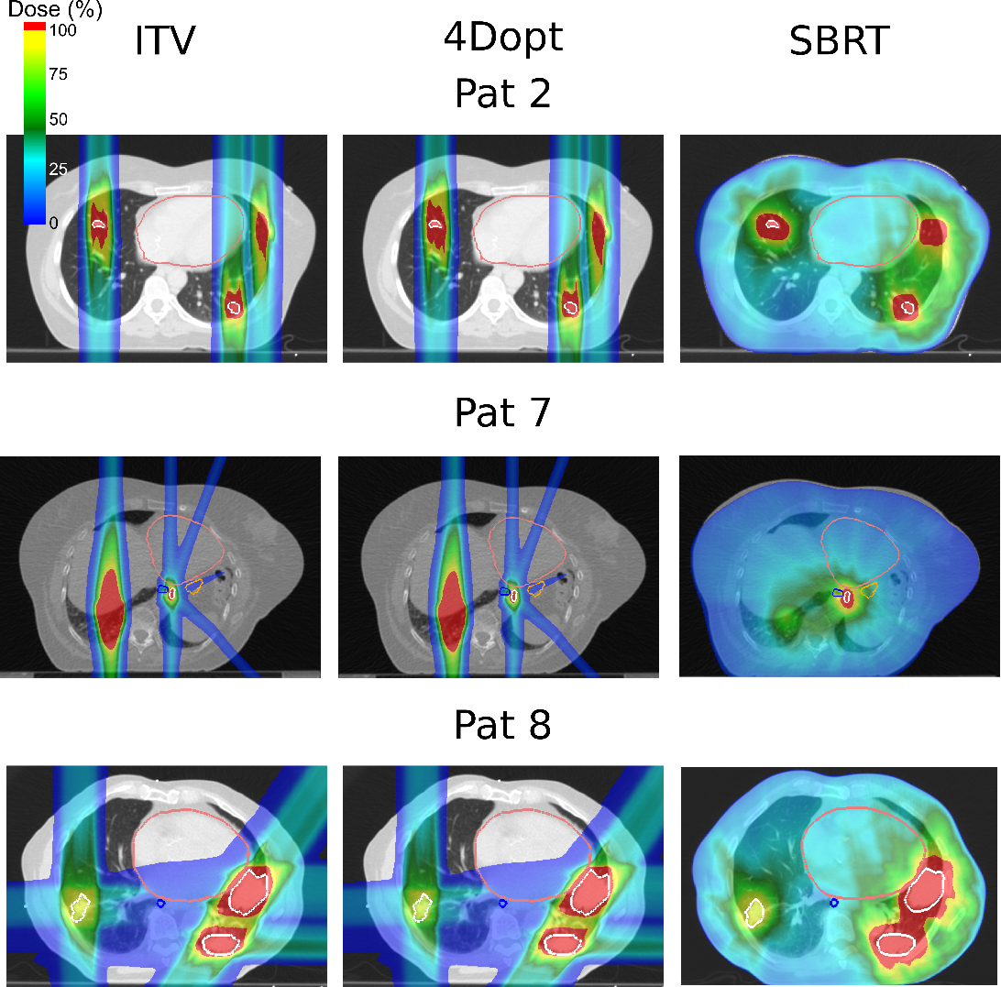
Complex Cases (show just PT and SBRT)

Slide 27
Complex Cases - Tumor Irradiation

Slide 28
Complex Cases - OAR Irradiation

Slide 29
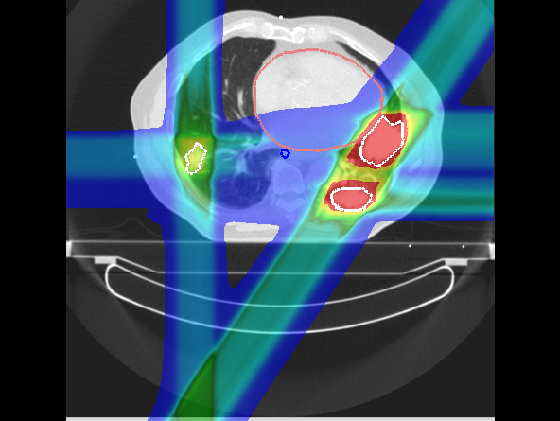
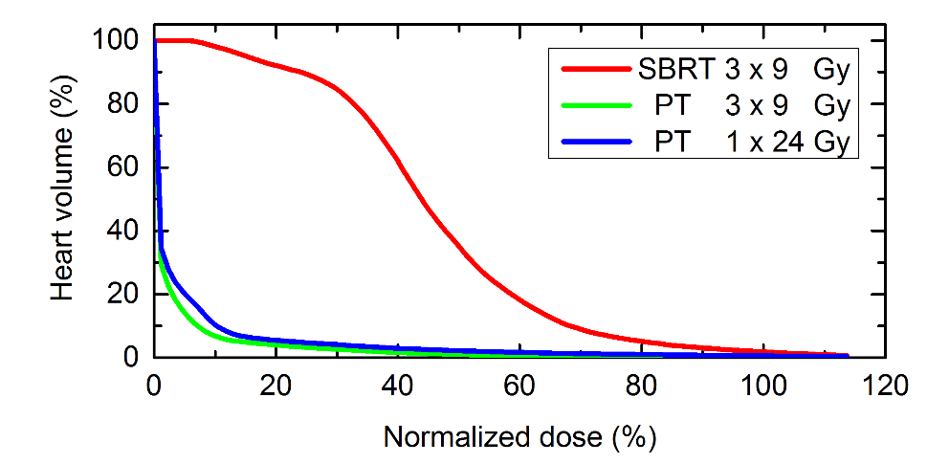
Complex Cases – dose escalation

Slide 30
Conclusions
PT delivers the same dose to tumors as SBRT
PT delivers significantely less dose to normal tissue
PT could deliver full ablative dose in single fraction, where SBRT could not
PT should be considered as a treamtent modality for lung cancer patients

Slide 31
Outlook
RTOG?
Löwe
NIRS

Slide 32
Acknowledgments
GSI
FC
Family

